Slide 1

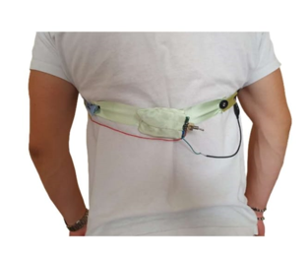
Measurement of Respiratory Rate
Luca De Bartolo
Simone..
Lorenzo ..
Francesco..
Macro..

Slide 2
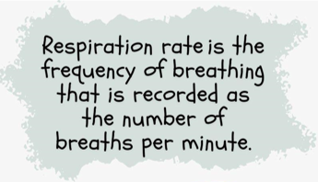
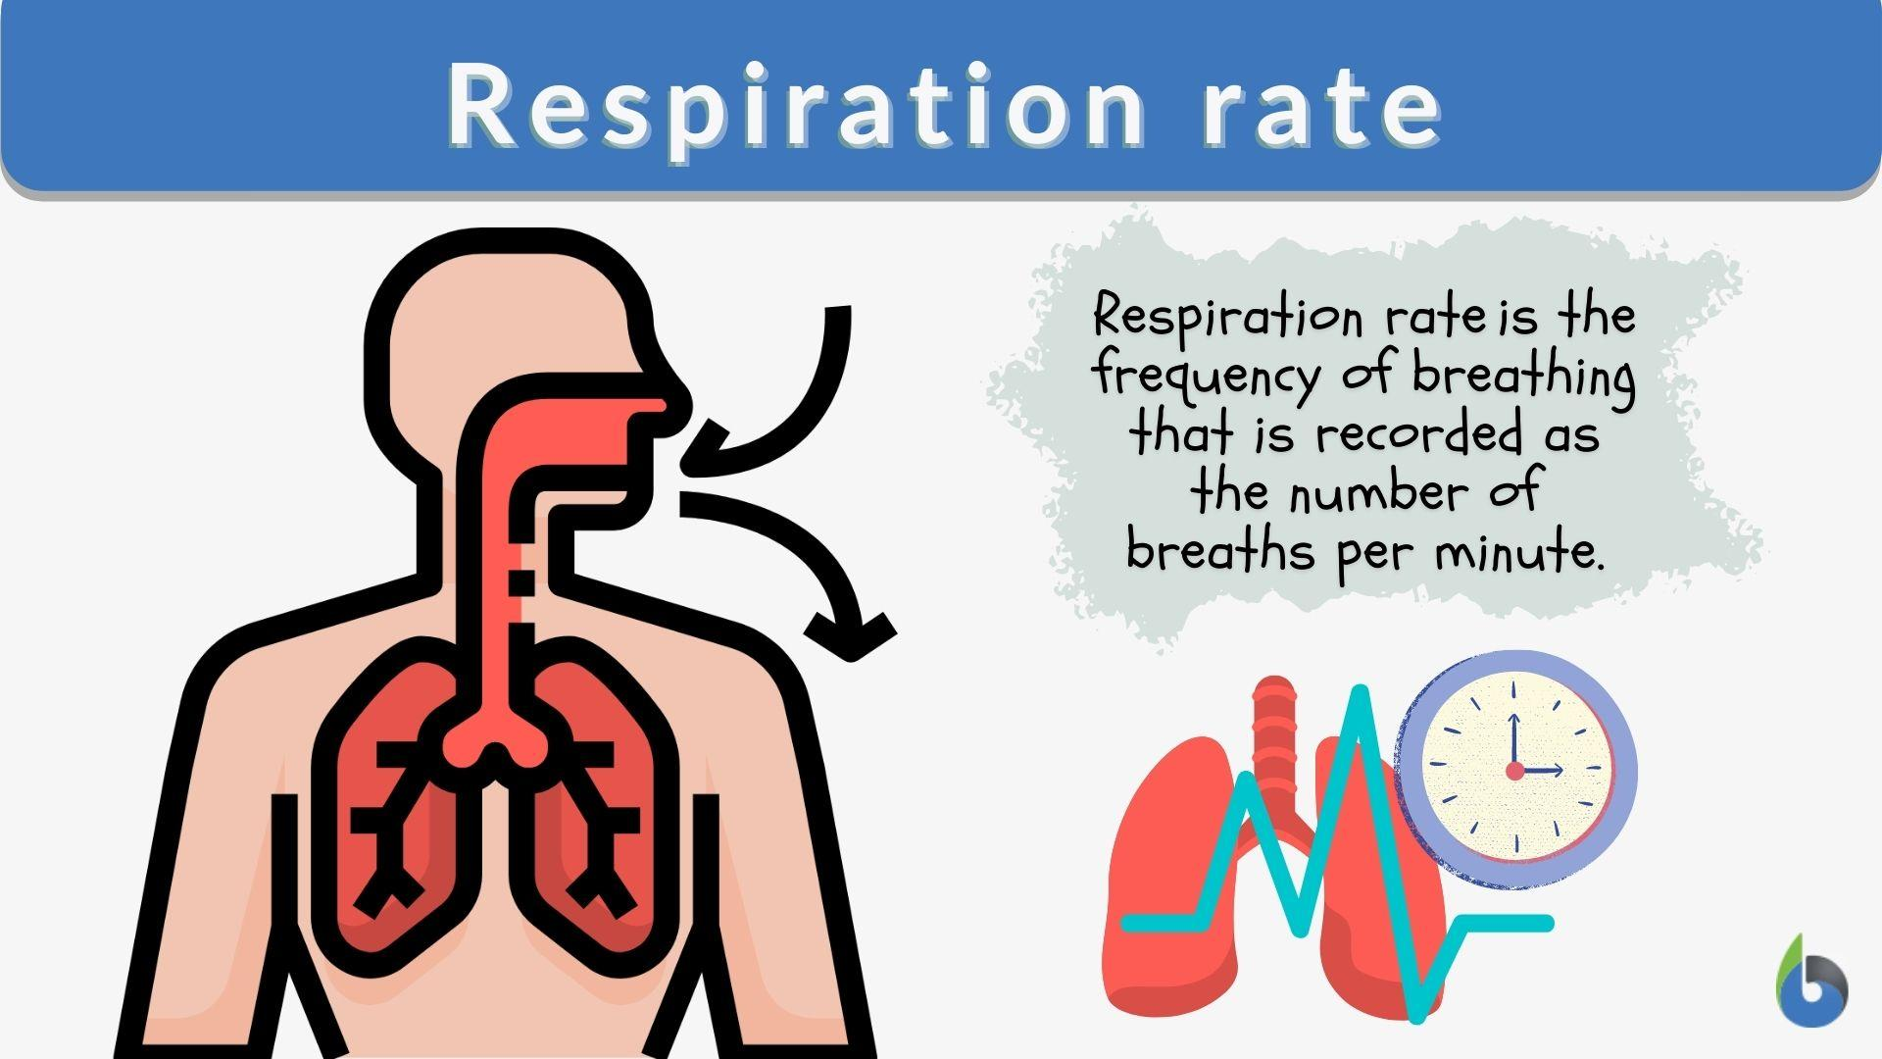

Respiratory Rate
Why it is important
Definition
Is a fundamental vital sign sensitive to various pathological conditions:
adverse cardiac events
clinical deterioration
stress factors
pneumonia

Slide 3
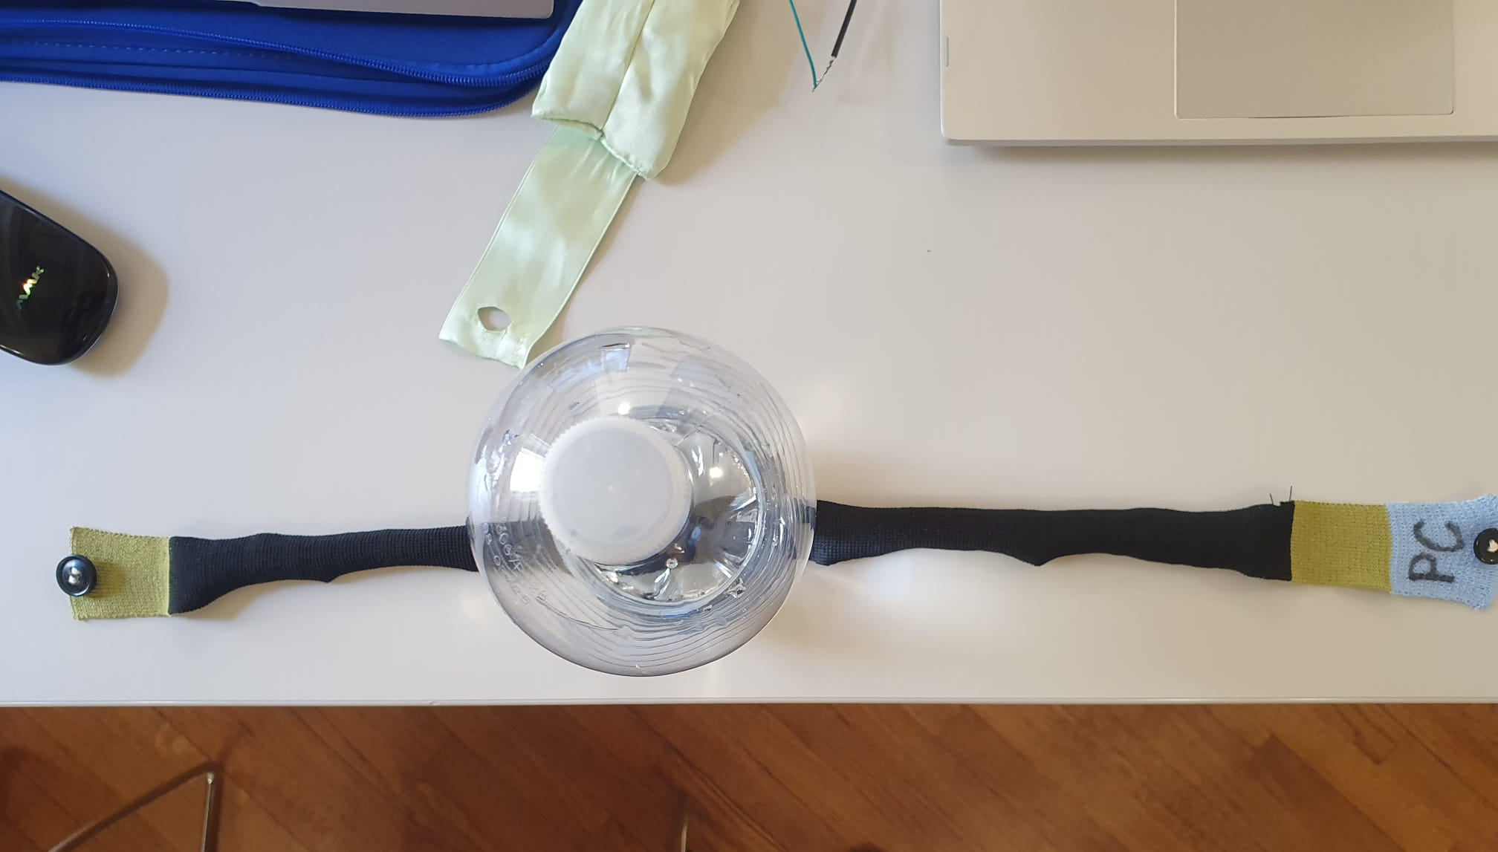
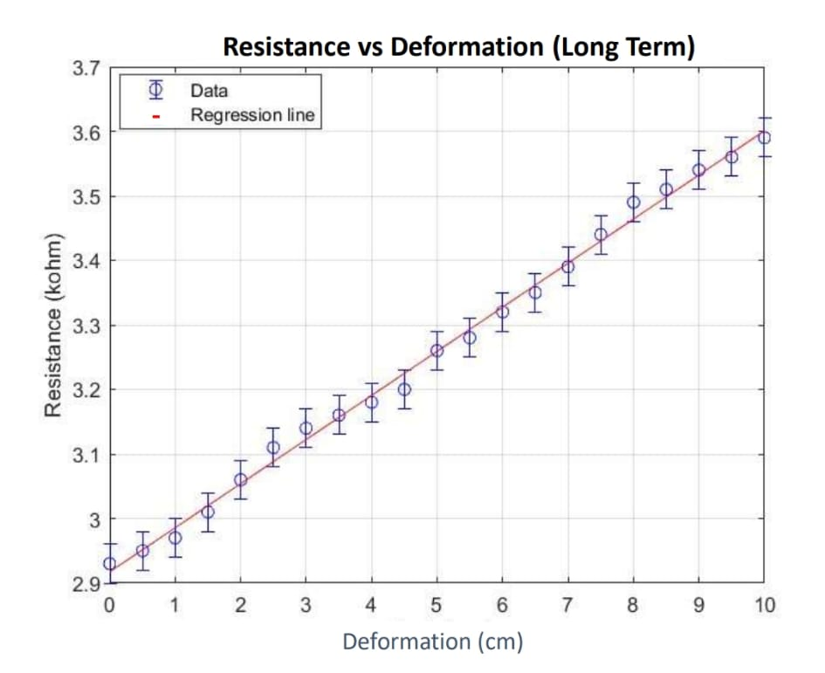
How do we measure it?
Resistive bandage/patch whose resistance varies depending on how much it is stretched

Slide 4
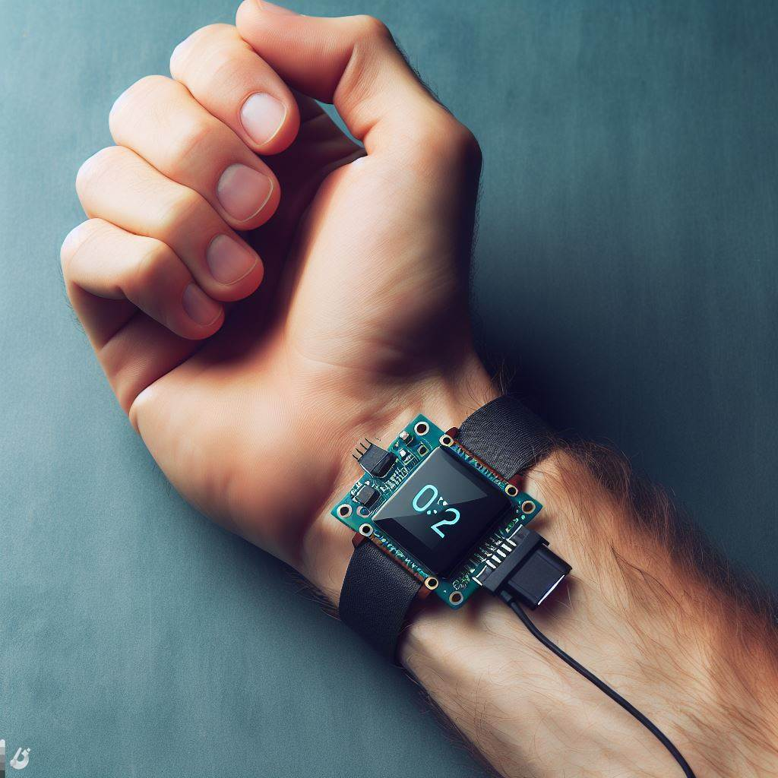
Project Overview and Divisions
Studio della benda resistiva a disposizione
Circuito di Condizionamento (Hardware)
Codice (Software)
PCB

Slide 5
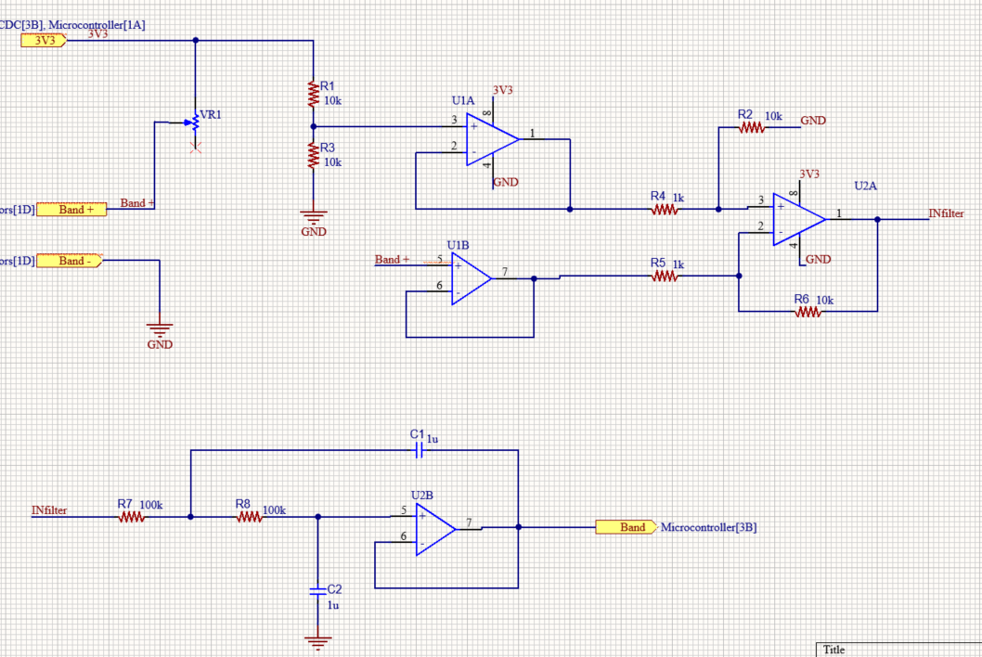
Hardware

Slide 6
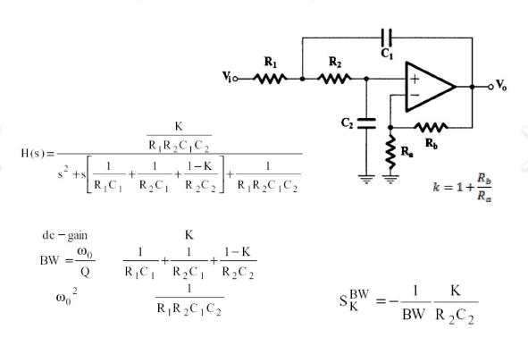
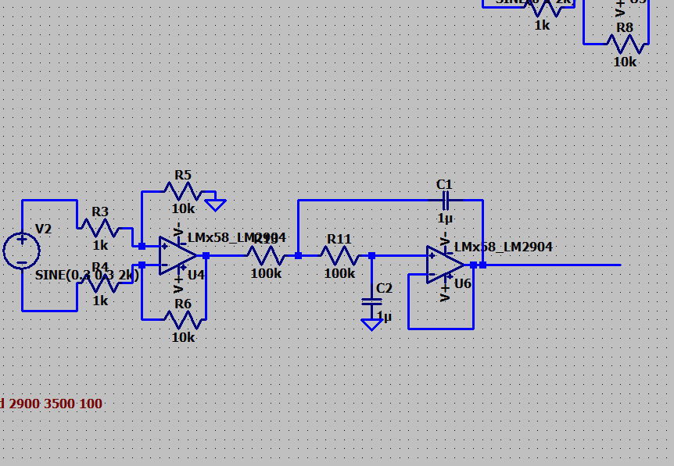
Hardware (2)

Slide 7
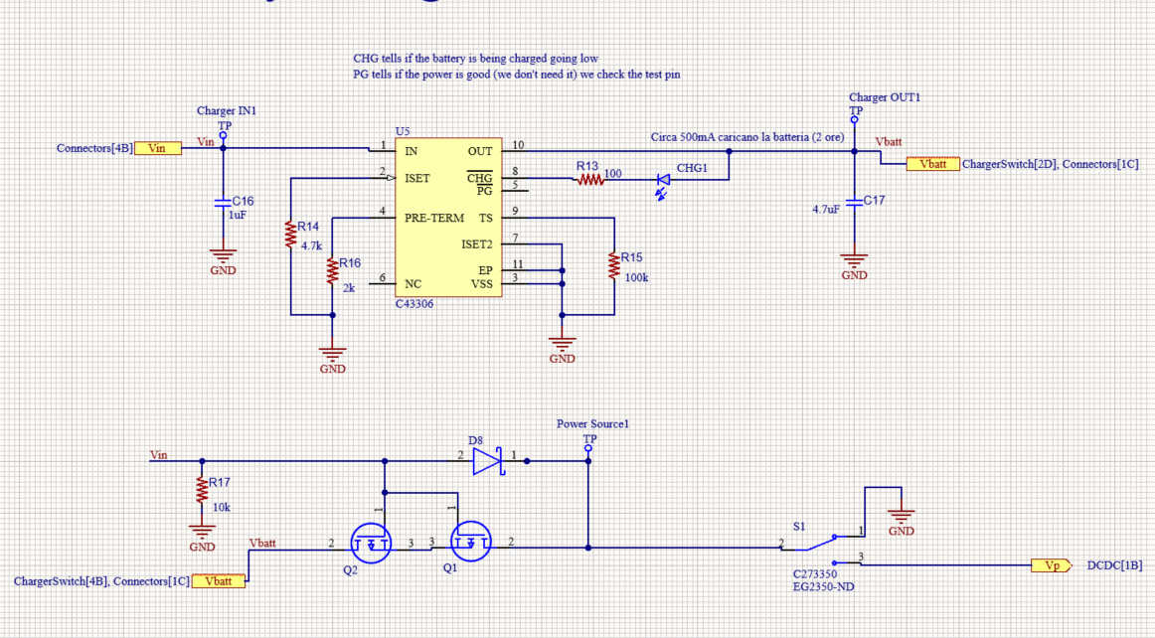
Hardware (3)

Slide 8

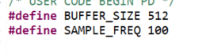
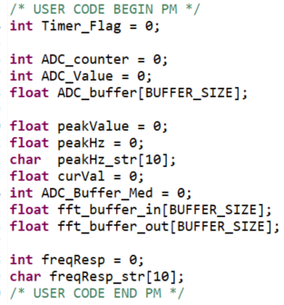
Software

Slide 9
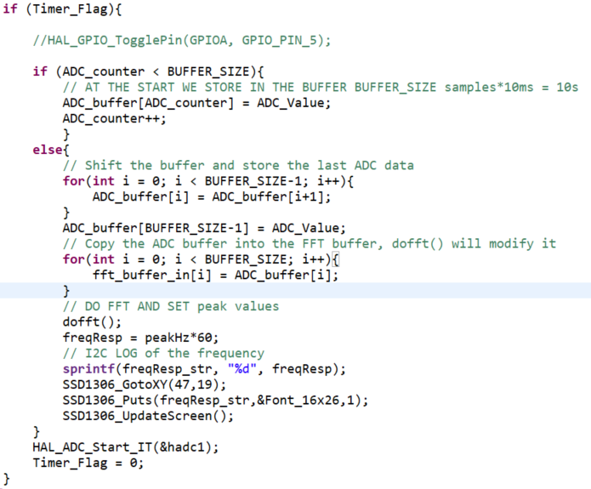
Software (2)

Slide 10
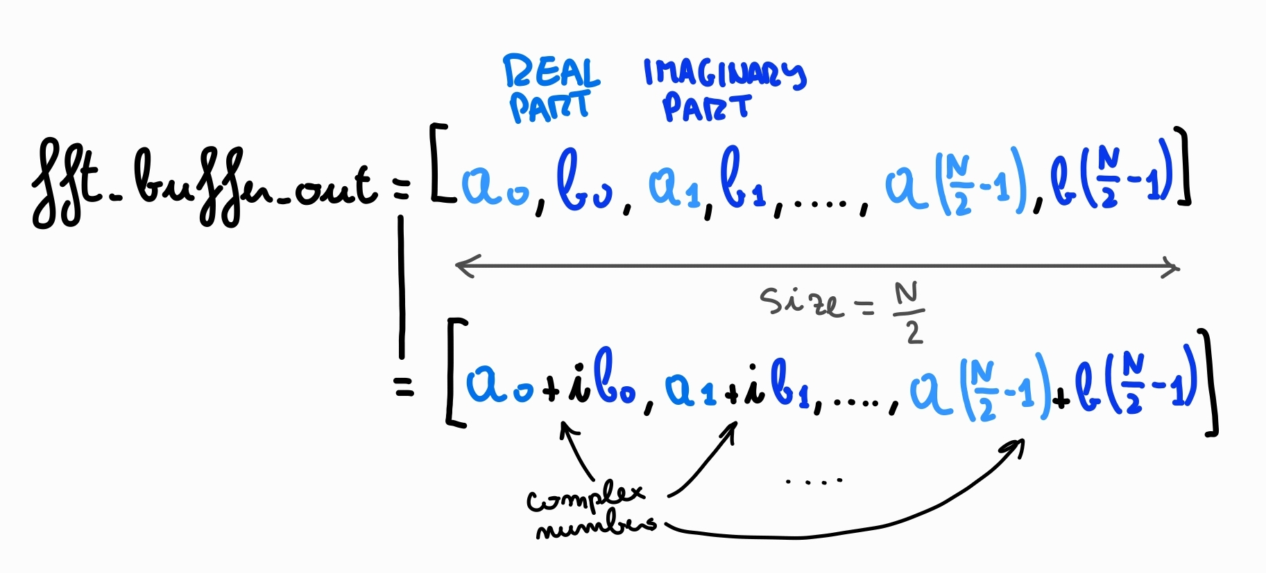
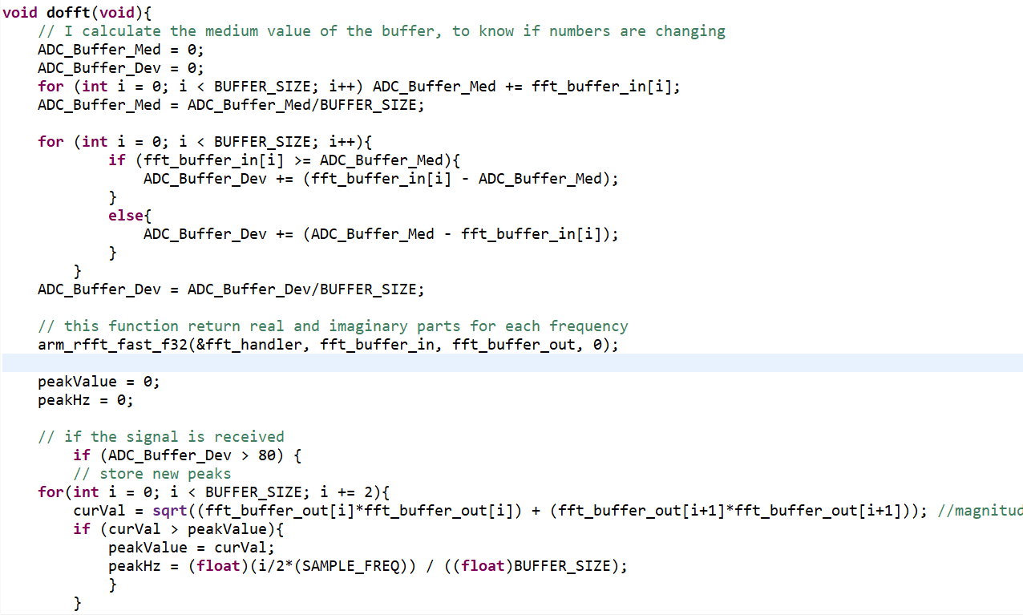
Software (3)

